Slide 1
Suomi NPP SDR Data Quality and IDPS
Changyong Cao, Ph. D.
VIIRS SDR Team Lead
NOAA/NESDIS/STAR
With contributed from: Fuzhong Weng, Yong Han, Larry Flynn,, Ninghai Sun,
and all SDR team members
Thanks to the workshop organizing committee,
Gary Jedlovec , Mitch Goldberg, and Jim Gleason for the invitation
Second Suomi NPP Applications Workshop
November 18-20, 2014

Slide 2
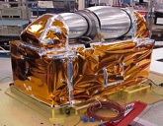
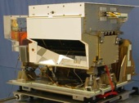
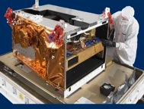
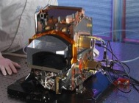
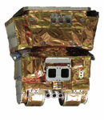
Suomi NPP and JPSS-1 Instruments
Instrument Type |  | Measurement
 | ATMS - Advanced Technology Microwave Sounder | ATMS and CrIS together provide high vertical resolution temperature and water vapor information needed to maintain and improve forecast skill out to 5 to 7 days in advance for extreme weather events, including hurricanes and severe weather outbreaks
 | CrIS - Cross-track Infrared Sounder
 | VIIRS – Visible Infrared Imaging Radiometer Suite | VIIRS provides many critical imagery products including snow/ice cover, clouds, fog, aerosols, fire, smoke plumes, vegetation health, phytoplankton abundance/chlorophyll
 | OMPS - Ozone Mapping and Profiler Suite | Ozone spectrometers for monitoring ozone hole and recovery of stratospheric ozone and for UV index forecasts
 | CERES - Clouds and the Earth’s Radiant Energy System | Scanning radiometer which supports studies of Earth Radiation Budget
2

Slide 3
Suomi NPP TDR/SDR Maturity
Sensor | Beta | Provisional | Validated
CrIS | February 10, 2012 | February 6, 2013 | March 18, 2014
ATMS | May 2, 2012 | February 12, 2013 | March 18, 2014
OMPS | March 7, 2012 | March 12, 2013 | September 3 , 2014
VIIRS | May 2, 2012 | March 13, 2013 | April 16, 2014
C
C
C
C
C
C
C
C
C
C
Beta
Early release product.
Initial calibration applied
Minimally validated and may still contain significant errors (rapid changes can be expected. Version changes will not be identified as errors are corrected as on-orbit baseline is not established)
Available to allow users to gain familiarity with data formats and parameters
Product is not appropriate as the basis for quantitative scientific publications studies and applications
Provisional
Product quality may not be optimal
Incremental product improvements are still occurring as calibration parameters are adjusted with sensor on-orbit characterization (versions will be tracked)
General research community is encouraged to participate in the QA and validation of the product, but need to be aware that product validation and QA are ongoing
Users are urged to consult the SDR product status document prior to use of the data in publications
Ready for operational evaluation
Validated
On-orbit sensor performance characterized and calibration parameters adjusted accordingly
Ready for use in applications and scientific publications
There may be later improved versions
There will be strong versioning with documentation
C
C
C
C

Slide 4
Suomi NPP Calibration/Validation Phases
Four Phases of Cal/Val:
  Pre-Launch; all time prior to launch – Algorithm verification, sensor testing, and validation preparation
  Early Orbit Check-out (first 30-90 days) – System Calibration & Characterization
  Intensive Cal/Val (ICV); extending to approximately 24 months post-launch – xDR Validation
  Long-Term Monitoring (LTM); through life of sensors after ICV
For each phase:
  Exit Criteria established
  Activities summarized
  Products mature through phases independently
Joint Polar Satellite System
10-28-2011
10-23-2012-Provisional Review
12-18-2013 Validated Review

Slide 5
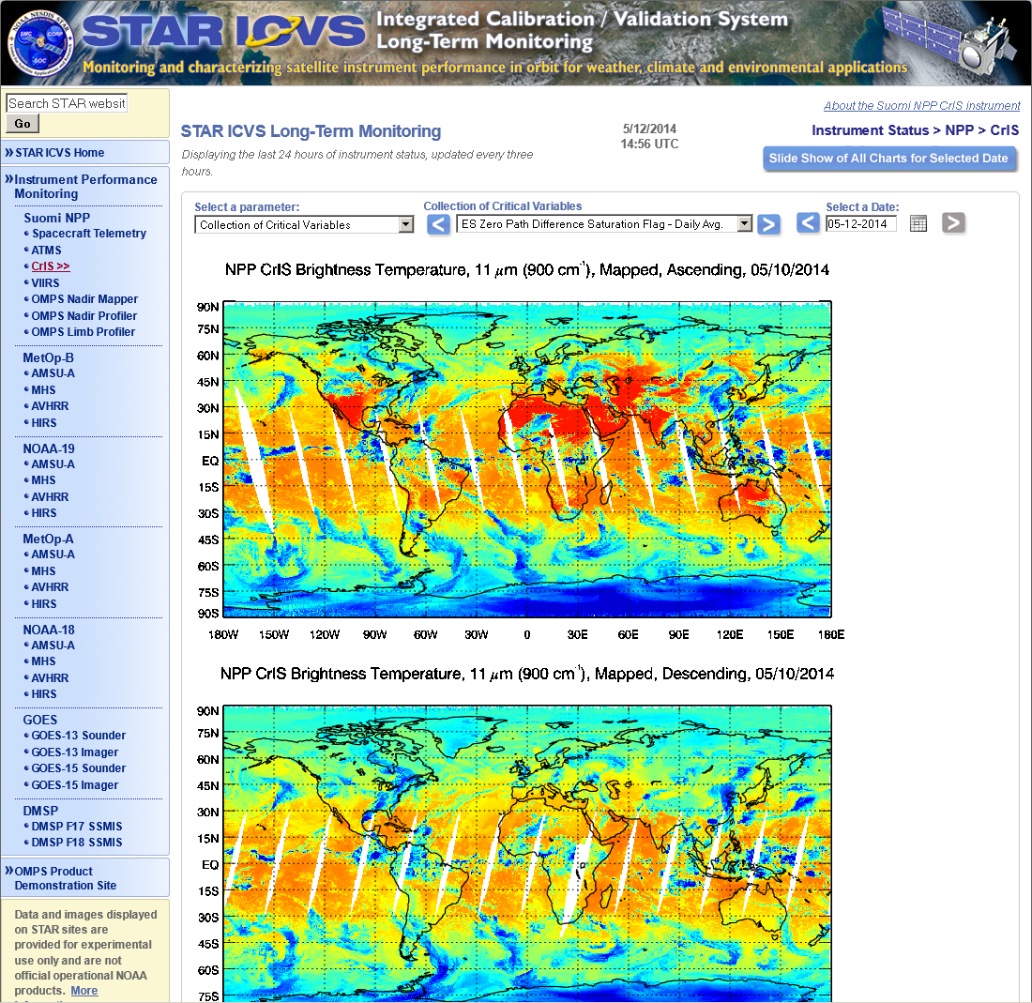
NOAA Integrated CalVal System (ICVS) for Long Term Monitoring (LTM) of Operational Satellites
http://www.star.nesdis.noaa.gov/icvs

Slide 6
Advanced Technology Microwave Sounder
(ATMS) TDR/SDR Status
TDR/SDR data have reached full validated maturity level
ATMS has stable instrument performance and calibration
ATMS instrument noises (NEDT) are characterized and all channels meet or exceed the requirements
All the ATMS channels have noises much lower than specification
ATMS processing coefficients table (PCT) are updated with nominal values
Quality flags (e.g. spacecraft maneuver and scanline, calibration) are updated and monitored
Geolocation errors for all the channels are quantified and meet specification
Instrument performance and SDR uncertainties are well characterized and documented (e.g. ATBD, peer-reviewed publications, user’s guide, error budget analysis)
Both TDR and SDR products are used in NOAA operations
Innovated sciences have been used for instrument calibration
Notes:
NPP Satellite Acquires First ATMS Measurements The image shows the ATMS channel 18 data, which measures water vapor in the lower atmosphere. Tropical Storm Sean is visible in the data, as the patch of blue, in the Atlantic off the coast of the Southeastern United States.

Slide 7
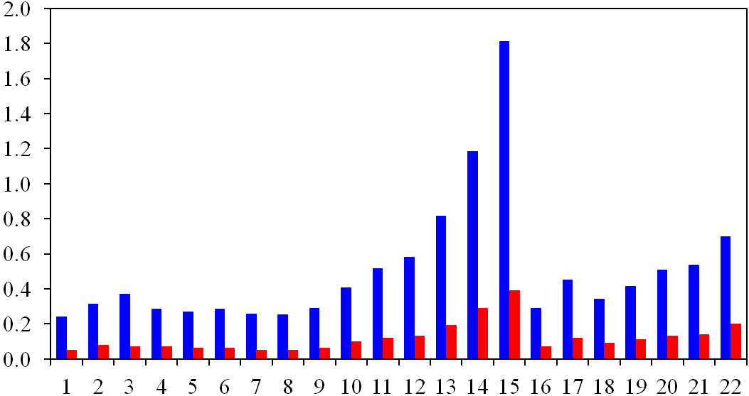
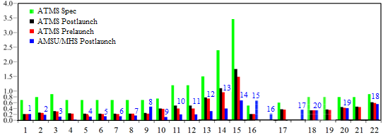
ATMS Noise Equivalent Temperature (NEDT)
Standard/Allan Deviation (K)
Channel Number
Channel Number
ATMS standard deviation (blue) and Allan deviation (red) with channel number. The sample size (N) is 150 and the averaging factor (m) for the warm counts is 17. The standard deviation is much higher than Allan deviation.
On-orbit ATMS noise from the standard deviation is lower than specification but is higher than AMSU/MHS. ATMS resample algorithm can further reduce the noise comparable to AMSU/MHS

Slide 8
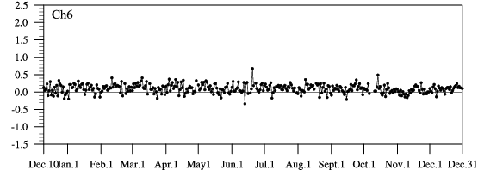
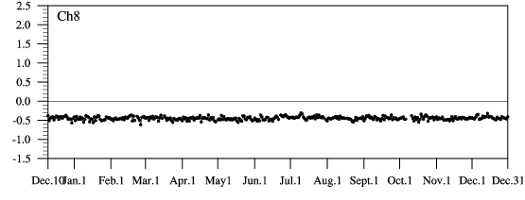
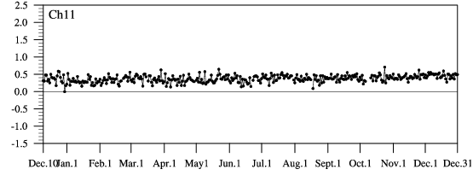
Stable ATMS Bias between Obs and Sim (COSMIC)

Slide 9
Cross-Track Infrared Sounder
(CRIS) SDR Status
CRIS SDR data have reached full validated maturity level
On-orbit instrument performance is stable and well within specification
SDR uncertainties meet requirements, with NEdN and uncertainties of radiometric and spectral calibration well below specifications
Spectral uncertainty: < 3 ppm, well below specification
Radiometric uncertainty: ~0.1K, well below specification
Geolocation error: < 1.2 km below specification
ILS and NL correction algorithms/code and coefficients are improved and adjusted
All the important SDR quality flags are functioning as expected
99.98% of the SDR data are in good quality
IDPS capability to process full resolution RDRs is implemented and tested
Instrument performance and SDR uncertainties are well characterized and documented (e.g. ATBD, peer-reviewed publications, user’s guide, error budget analysis)
CrIS SDR team developed innovative algorithms for full resolution SDR processing
Notes:
NPP Satellite Acquires First ATMS Measurements The image shows the ATMS channel 18 data, which measures water vapor in the lower atmosphere. Tropical Storm Sean is visible in the data, as the patch of blue, in the Atlantic off the coast of the Southeastern United States.

Slide 10
SNPP CrIS Full Spectral Resolution SDR
Frequency Band | Spectral Range (cm⁻¹) | Number of Channel | Spectral Resolution (cm⁻¹)
LWIR | 650 to 1095 | 713 (713) | 0.625 (0.625)
MWIR | 1210 to 1750 | 865 (433) | 0.625 (1.25)
SWIR | 2155 to 2550 | 633 (159) | 0.625 (2.5)
Red: Full resolution mode
CH₄
CO
CO₂

Slide 11
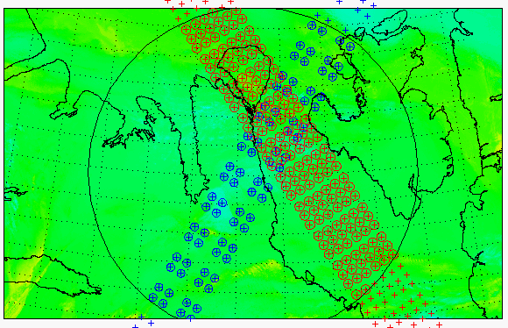
SNO between CrIS and IASI
SNO Criteria
Time difference:
<= 120 seconds
Pixel distance:
<=(12+14)/4.0 km = 6.5 km
Zenith angle difference: ABS(cos(a1)/cos(a2)-1) <= 0.01
Data collected during the SNO event on 08/27/2013
More data are needed to provide statistically meaningful results

Slide 12
Visible Infrared Imaging Radiometer Suite
(VIIRS) SDR Status
SNPP SDR products have reached validated maturity level
Multiple code/LUT updates have been implemented or are being implemented into the SDR processing, including the scan-by-scan calibration, and have led to higher quality SDRs and EDRs.
VIIRS on-orbit performance is well characterized and meets specifications
Noise is small and stable, meet specification
Bias (accuracy) is well characterized for both reflective solar and thermal emissive bands. with the exception of M11 due to low signal (known prelaunch with waiver)
RSB Autocal is being implemented which will reduce calibration latency and improve performance.
DNB straylight correction works well.
Geo-location uncertainties for I-/M-bands are ~ 70 m at nadir, meeting specifications at nadir and edge-of-scan (DNB terrain corrected geo-location has been implemented 5/14)
Instrument performance and SDR uncertainties are well characterized and documented (e.g. ATBD, peer-reviewed publications, user’s guide, error budget analysis)
Notes:
Early on August 28, 2012, the Visible Infrared Imaging Radiometer Suite (VIIRS) on the Suomi-NPP satellite captured this nighttime view of Tropical Storm Isaac and the cities near the Gulf Coast of the United States. The image was acquired just after local midnight by the VIIRS “day-night band,” which detects light in a range of wavelengths from green to near-infrared and uses light intensification to enable the detection of dim signals. In this case, the clouds of Isaac were lit by moonlight.

Slide 13
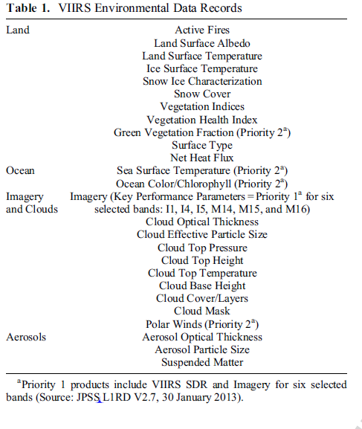
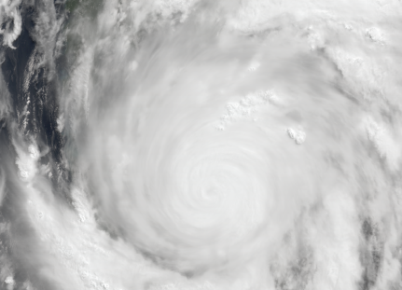
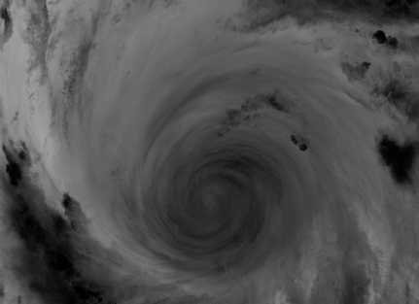
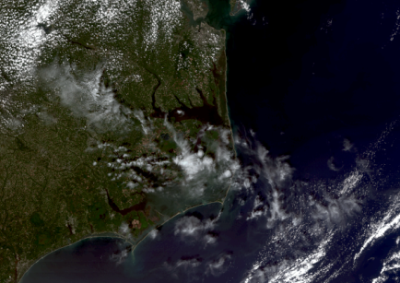
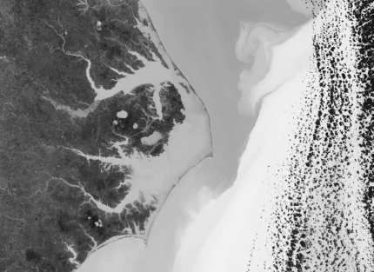
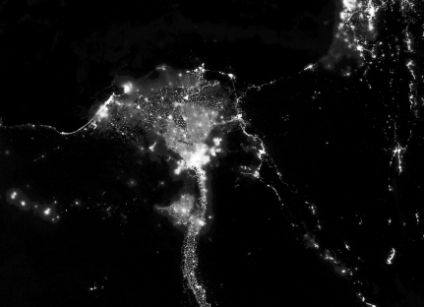
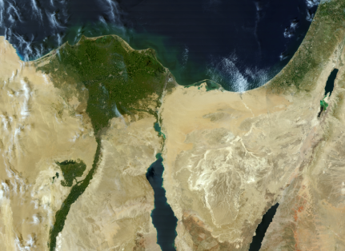
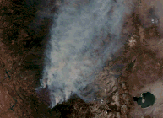
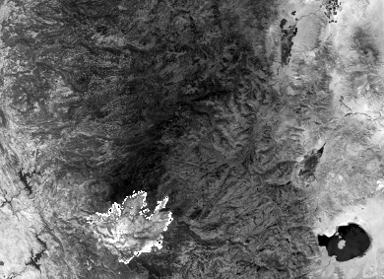
VIIRS Environmental Data Records (EDR)
Typhoon Haiyan: VIIRS M3,M4,M5
Typhoon Haiyan: VIIRS I5
Cape Hatteras: VIIRS M2,M4,M5
Cape Hatteras: VIIRS I5
Cairo: VIIRS DNB
Cairo: VIIRS M2,M4,M5
RIM Fire: VIIRS M3,M4,M5
RIM Fire: VIIRS I4
Images Courtesy: https://cs.star.nesdis.noaa.gov/NCC/GalleryPage04

Slide 14
VIIRS On-orbit Performance
-SNR and NEDT
Excellent noise performance for all VIIRS bands
Noise values stable since launch

Slide 15
VIIRS SDR Accuracy/Uncertainty
 | Requirement (absolute uncertainty for uniform scenes) | Prelaunch and onboard calibration | Validation: Relative to MODIS/CrIS/IASI/other thru Inter-comparisons | Note
VIIRS RSB | Uncertainty: 2% typical reflectance; 0.3% stability; 0.1% desirable for Ocean Color Applications | 1.2% for M1-M7; 1.5% for M8&9 1.4% for M10 1.3% for I1&I2 1.6% for I3 | 2% (±1%) for matching bands | Except bands with very low signal (ex. M11); sub-percent (such as 0.1%) accuracy and stability for Ocean Color is very challenging. Geolocation error: expectation is half I-band pixel; achieved better than quarter I-band pixel (1-σ)
VIIRS TEB | M12/M13: 0.7%(0.13K) @270K M14: 0.6% (0.26K) @ 270K M15/M16: 0.4% (0.22K/0.24K) @270K I4: 5% (0.97K) @270K I5: 2.5% (1.5K) @270K | Better than 0.13K for all M bands except M13 (0.14); 0.47K for I4; 0.23K for I5 | 0.1K based on statistical comparison with MODIS and CrIS ER-2/SHIS Aircraft underflight shows excellent agreement M15 0.4 K bias relative to CrIS at 200K (in spec.) | M15 at 190K requirement is 2.1% radiance or 0.56K Geolocation uncertainty: expectation was half I-band pixel; achieved better than quarter I-band pixel (1-σ) Striping is at noise level but is amplified by SST algorithm
VIIRS DNB | 5%, 10%,30% L_{min} (LGS,MGS,HGS) | 3.5%, 7.8%, and 11% (LGS, MGS, HGS) | 4%, 7.7%, 11.8% (LGS, MGS, HGS) | Geolocation error is a ~10th of a pixel (1-σ) on the ellipsoid earth but can exceed 1km (up to 24 km at the edges of scan) without terrain correction
VIIRS Major challenge: sync loss and SBC lockup

Slide 16
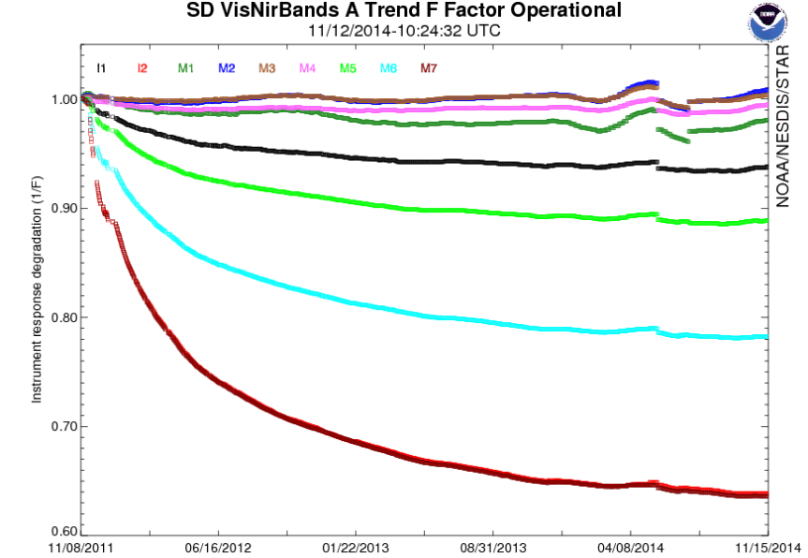
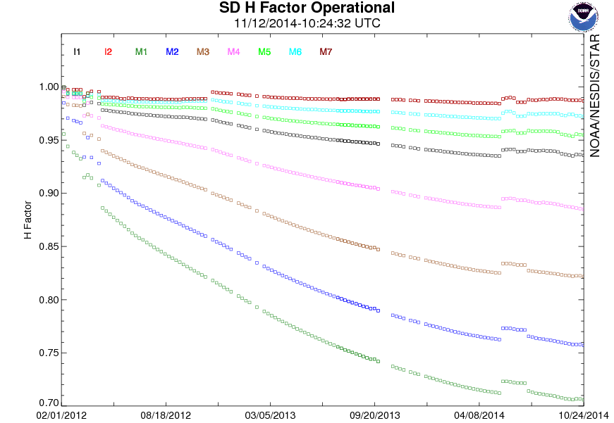
VIIRS RTA and Solar Diffuser Degradation
VIIRS RTA mirror responsivity degradation (1/F-factor) is leveling off
For M7, initially > 2% per week; Currently <0.1% per week
Solar diffuser (1/H-factor) degradation continues
Both H and F factor degradation flattened in the spring of 2014, which disrupted the trend. As a result, the calibration model has to be revised
Automated calibration of the solar bands using the “RSB Autocal” is currently being tested
Initial degradation >2% per week
F-Factor
Degradation(M7) <0.1% per week
H-Factor

Slide 17
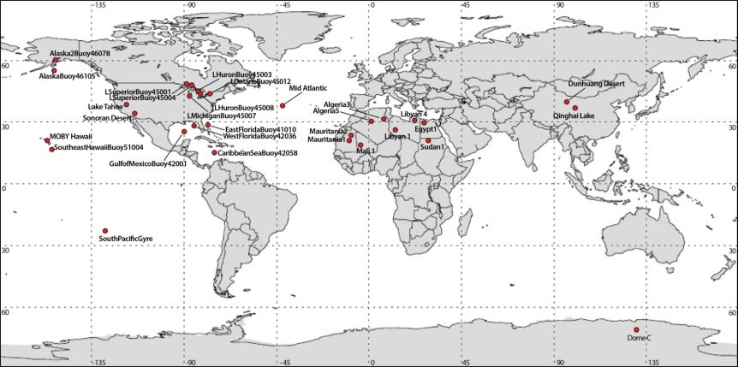
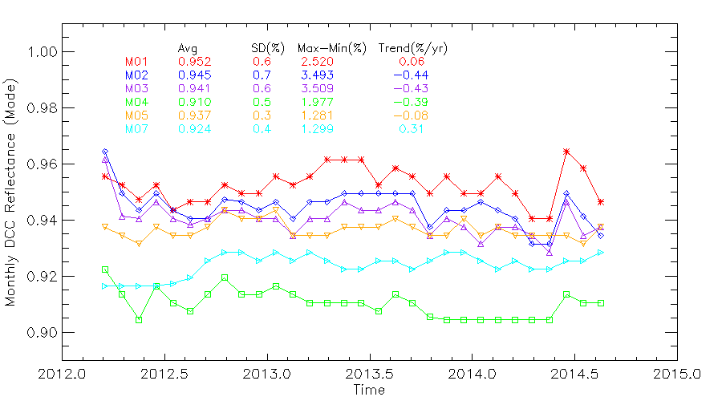
VIIRS Performance at 30 Vicarious Sites Worldwide
VIIRS calibration is monitored at 30 Vicarious sites with time series analysis for all bands
DCC and Lunar are recognized as a unique sites and have been used to diagnose calibration anomalies
The DCC time series are capable of detecting sub-percent calibration changes.
  Bands M5 and M7 are stable, with calibration of stability better than 0.4% (1-sigma);
  Bands M1-M3 show noticeable calibration changes, especially since early 2014, due to the SD anomaly
Time series available at:
http://ncc.nesdis.noaa.gov/VIIRS/VSTS.php
Feb 2014
30 vicarious sites for VIIRS calibration monitoring
Nadir
VIIRS DCC observation time series

Slide 18
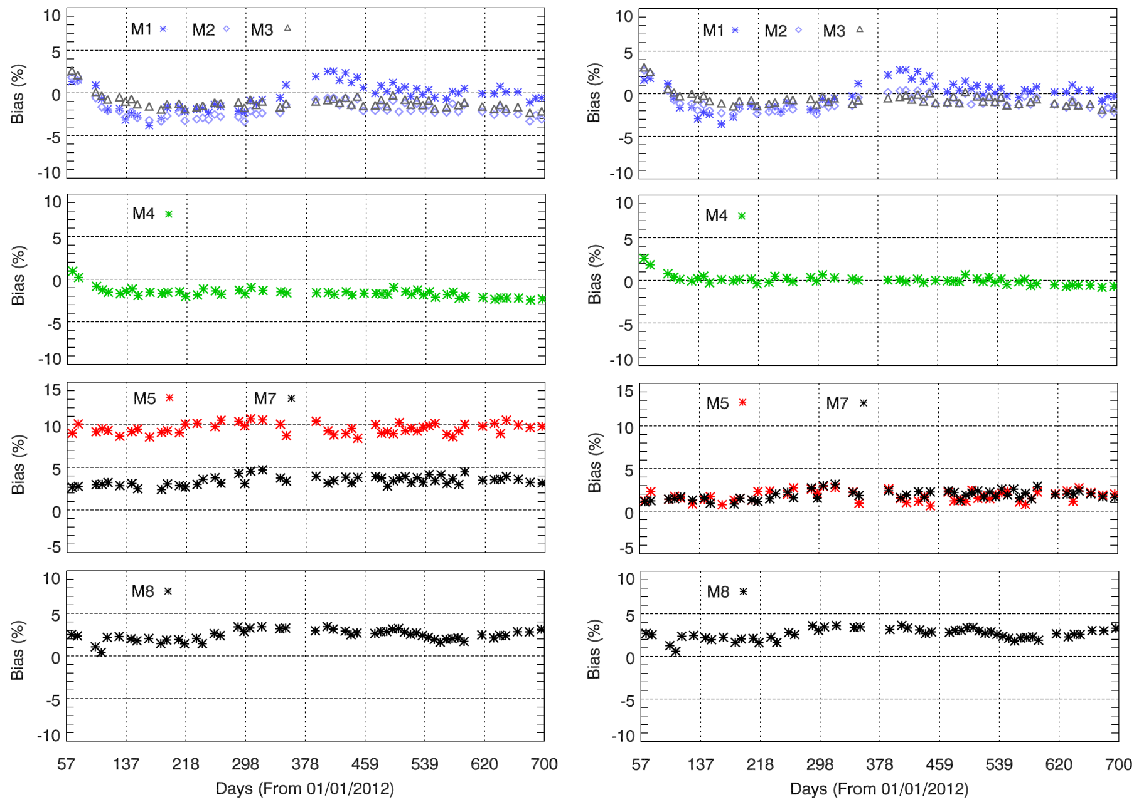
VIIRS and MODIS RSB Inter-comparison at SNO-x
(over desert)
BEFORE accounting for SRF difference
AFTER accounting for SRF difference

Slide 19
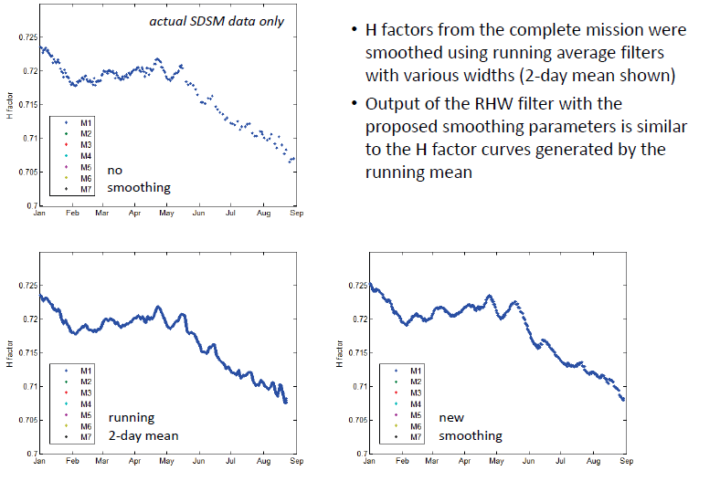
RSB Autocal and Implementation Challenges
(Issues with the RHW filter)

Slide 20
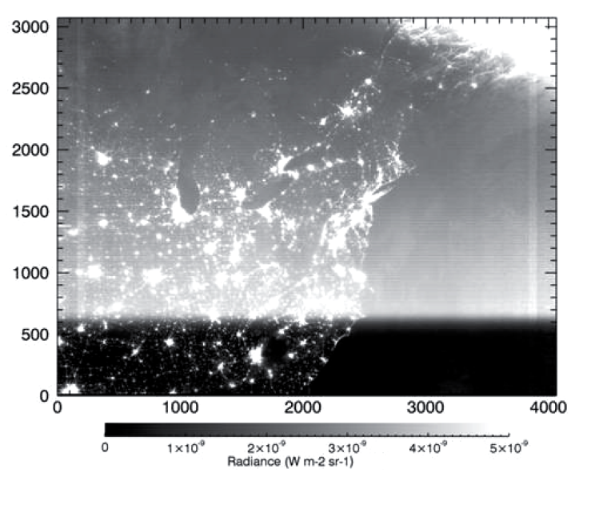
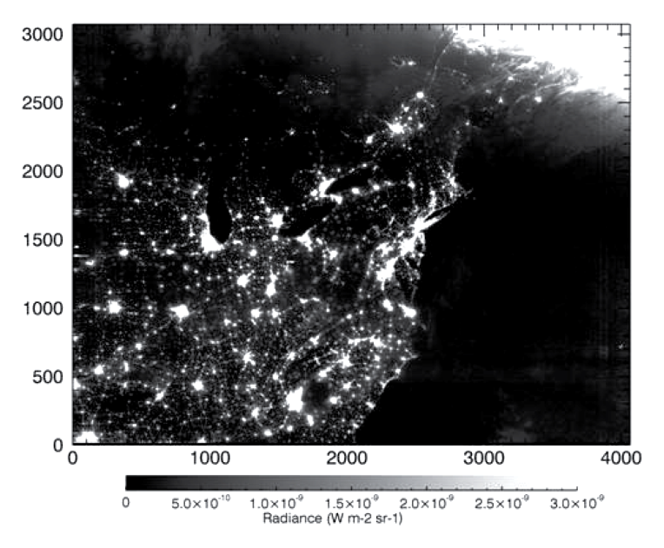
DNB Straylight Correction
Straylight intensity at Lmin (minimum detectable radiance)
Empirical correction based on earth view data analysis
Run the software in Matlab & generate Look Up Table (LUT) monthly (operational since Aug. 2013)
Correction very effective for most data, except small residuals in the polar region
Correction restores the correct radiances
Before correction
After correction

Slide 21
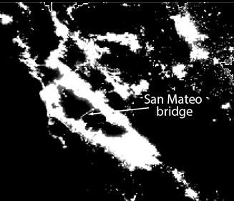
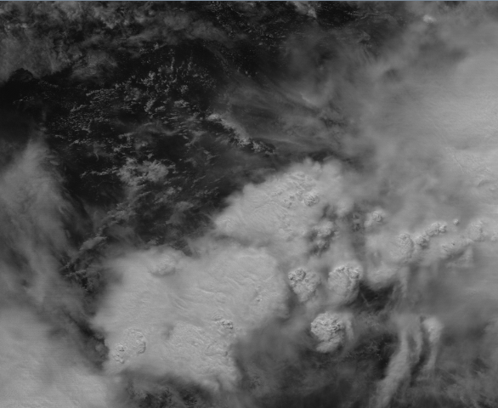
DNB low radiance performance monitoring
Approaches used:
Validation at Dome C and Greenland under lunar illumination
Monitoring using bridge lights (e.g., San Mateo bridge) for stability near Lmin
Deep convective clouds during night (lunar for high gain) and day (solar for low gain)
New initiative developing SI traceable night light source (SBIR)
Bridge lights
DCC

Slide 22
Ozone Mapping and Profiling Suite
(OMPS) SDR Status
SNPP Earth View SDR products has reached validated maturity level
Excellent OMPS instrument performance, as validated by STAR ICVS monitoring.
Calibration coefficients have been adequately updated.
OMPS and GOME-2 inter-sensor biases are well characterized. Good agreements with existing knowledge of GOME-2 calibration.
Excellent outreach to and feedback from NOAA and NASA user community.
OMPS SDR on-orbit performance is well characterized. Exceptional performance in terms of noise, stability, and data completeness.
Further improvements in stray light correction is being implemented. Current performance meets requirements.
Initial wavelength correction is being implemented, after which performance will meet requirements.
Need a plan to correct for cross-track variation, e.g. by improved pixel-to-pixel cal or soft cal.
Good documentation in peer-reviewed papers and presentations for this review.

Slide 23
OMPS Nadir Mapper Instrument Performance
Requirement | Specification/Prediction Value | On-Orbit Performance
Non-linearity | < 2% full well | < 0.46%
Non-linearity Knowledge | < 0.5% | ~0.1%
On-orbit Wavelength Calibration | < 0.01 nm | 0.01 nm #
Stray Light NM Out-of-Band + Out-of-Field Response | ≤ 2% | average ~± 0.5% ^
Intra-Orbit Wavelength Stability | <0.02 nm | < 0.01 nm *
SNR | >1000 | > 1000 from SV and EV
Inter-Orbital Thermal Wavelength Shift | <0.02 nm | <0.01 nm
CCD Read Noise | <60 –e RMS | < 25 –e RMS
Detector Gain | >46 | ~42
Absolute Irradiance Calibration Accuracy | < 7% | 5%
Absolute Radiance Calibration Accuracy | < 8% | < 5%
# After new analysis for Day 1 wavelength scale.
^ After measurement-based correction using prelaunch characterization.
* After measurement-based intra-orbit adjustments.
23
Notes:
From SDR provisional presentation with new notes by L. Flynn.

Slide 24
OMPS NP Instrument Performance
Requirement | Specification/Prediction Value | On-Orbit Performance
Non-linearity | < 2% full well | < 0.46%
Non-linearity Knowledge | < 0.5% | ~0.1%
On-orbit Wavelength Calibration | < 0.01 nm | < 0.01 nm #
Stray Light NM Out-of-Band + Out-of-Field Response | ≤ 2% | average ~± 1% *
Intra-Orbit Wavelength Stability | <0.02 nm | < 0.01 nm
SNR | Channel Dependent | As good as SBUV/2 at Alg. Channels &
Inter-Orbital Thermal Wavelength Shift | <0.02 nm | 0.03-nm amplitude annual cycle ^
CCD Read Noise | <60 –e RMS | < 25 –e RMS
Detector Gain | >43 | ~45
Absolute Irradiance Calibration Accuracy | < 7% | 1~10% , average: ~7%
Absolute Radiance Calibration Accuracy | < 8% | < 5%
# After new analysis of Day 1 Solar
* After measurement-based correction using prelaunch characterization
^ Regular annual cycle affects accuracy and stability
& Information concentration possible by using near-by channels.
Notes:
From C. Pan SDR Provisional.
New notes from L. Flynn.

Slide 25
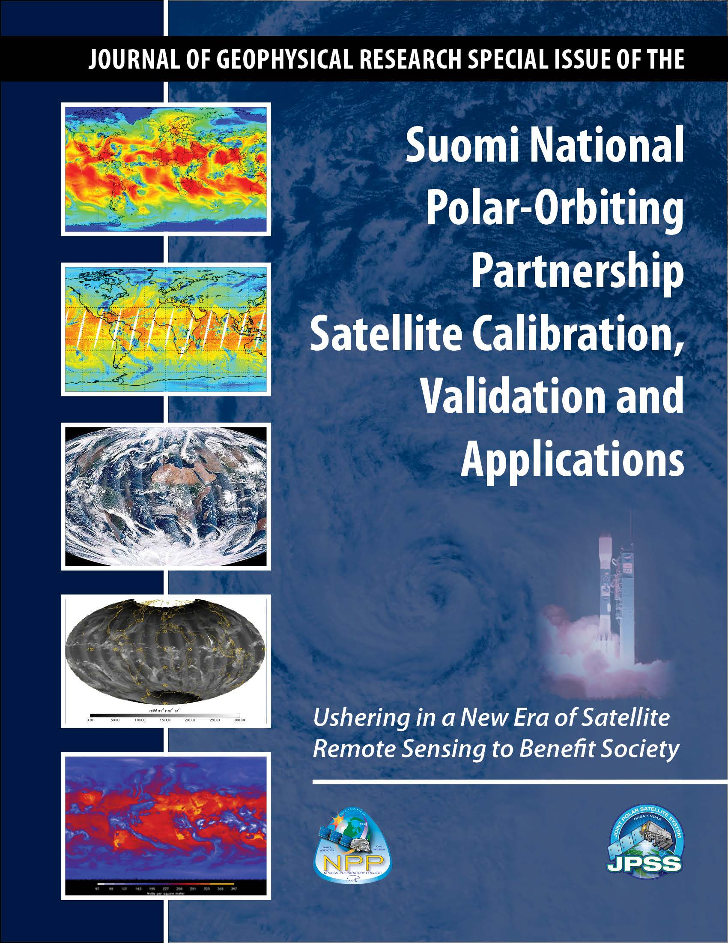
JGR Special Issue on Suomi NPP CalVal
34 papers have been published in AGU Journal Geophysical Research Special Issue on Suomi NPP satellite calibration, validation and applications.
Guest Editor: Fuzhong Weng

Slide 26
Summary
  Suomi NPP instrument calibration and validation tasks have been completed successfully and all the SDR products have been used in NOAA operations
  CrIS, ATMS, VIIRS and OMPS have stable performance with the key instrument parameters (e.g. noise, bias) meeting or exceeding the requirements
  SDR teams developed innovative sciences and algorithms for improving and refining the products processing system, e.g., CrIS full spectral resolution processing and ATMS full radiance processing, VIIRS DNB straylight corrections and low radiance monitoring.
  NOAA has developed an Integrated CalVal System (ICVS) for long-term monitoring (LTM) of all SNPP/JPSS/GOES-R/METOP instruments
  Documentation of all the SNPP SDR sciences and operational codes have been completed, including ATBD and user manuals, error budgets. Peer-review papers have been published in JGR special issue and other high quality journals
  SDR teams start working on J1 prelaunch characterizations for all instruments, preparing for J1 SDR algorithm upgrades.

Slide 27
Backup slides

Slide 28
VIIRS SDR Peer Reviewed Publications
Cao, C., F. Deluccia, X. Xiong, R. Wolfe, and F. Weng, 2013a, Early On-orbit Performance of the Visible Infrared Imaging Radiometer Suite (VIIRS) onboard the Suomi National Polar-orbiting Partnership (Suomi-NPP) Satellite, IEEE Transaction
on Geoscience and Remote Sensing, DOI:10.1109/ TGRS.2013.2247768.
Cao, C., X. Xiong, S. Blonski, Q. Liu, S. Uprety, X. Shao, Y. Bai, F. Weng, 2013, Suomi NPP VIIRS sensor data record verification, validation, and long-term performance monitoring, JGR Special Issue, DOI: 10.1002/2013JD020418
Xiong, X., J. Butler, K. Chiang, B. Efremova, J. Fulbright, N. Lei, J. McIntire, H. Oudrari, J. Sun, Z. Wang, A. Wu (2013), VIIRS On-orbit Calibration Methodology and Performance, JGR Special Issue, DOI: 10.1002/2013JD020423.
Wolfe, R., G. Lin, M. Nishihama, K. P. Tewari, J. C. Tilton, A. R. Isaacman et al., 2013, Suomi NPP VIIRS prelaunch and on-orbit geometric calibration and characterization, DOI: 10.1002/jgrd.50873, JGR special issue.
Liao. L.B., S. Weiss, S. Mills, B. Hauss (2013), Suomi NPP VIIRS Day-Night-Band (DNB) On-Orbit Performance, Journal of Geophysical Research-Atmosphere, DOI: 10.1002/2013JD020475.
Rausch, K. et al., VIIRS RSB Autocal, JGR special issue , in press.
Uprety, S., C. Cao, X. Xiong, S. Blonski, A. Wu, and X. Shao, 2013, Radiometric Inter-comparison between Suomi NPP VIIRS and Aqua MODIS Reflective Solar Bands using Simultaneous Nadir Overpass in the Low Latitudes, JTech , doi: http://dx.doi.org/10.1175/JTECH-D-13-00071.1.
Cao, C., X. Shao, S. Uprety, (2013b), Detecting Light Outages After Severe Storms Using the Suomi-NPP/VIIRS Day Night Band Radiances, IEEE Geoscience and Remote Sensing Letters, DOI: 10.1109/LGRS.2013.2262258, in press.
Liu, Q., C. Cao, and F. Weng, 2013, Assessment of Suomi National Polar-Orbiting Partnership VIIRS Emissive Band Calibration and Inter-Sensor Comparisons, IEEE JSTAR, 10.1109/JSTARS.2013.2263197.
Liu, Q., C. Cao, and F. Weng, 2013: Striping in the Suomi NPP VIIRS Thermal Bands through Anisotropic Surface Reflection, J. Atmos. Oceanic. Technol., 30, 2478–2487. doi: http://dx.doi.org/10.1175/JTECH-D-13-00054.1
Plus over ~80 conference papers.
Other VIIRS SDR papers at this conference:
Lunar calibration, DCC calibration, rayleigh scattering, DMSP calibration, Calibration Knowledgebase.

Slide 29
VIIRS SDR Requirements and Performance
(all performance values are stable since provisional)
Band | Driving EDR(s) | Center Wavelength (μm) | Equiv. Width (μm) | Horizontal Sample Interval (km) (track × scan) |  | Band Gain | Ltyp or Ttyp (Spec) | Lmin or Tmin | Lmax or Tmax | Spec SNR or NEdT (K) | On Orbit SNR or NEdT (K) | MODIS equiv. band
 |  |  |  | Nadir | End of Scan
VisNIR
M1 | Ocean Color Aerosol | 0.411 | 0.0198 | 0.75×0.75 | 1.60x1.58 | H | 44.9 | 30 | 135 | 352 | 588 | B8
 |  |  |  |  |  | L | 155 |  | 615 | 316 | 1045
M2 | Ocean Color Aerosol | 0.444 | 0.0143 | 0.75×0.75 | 1.60x1.58 | H | 40 | 26 | 127 | 380 | 572 | B9
 |  |  |  |  |  | L | 146 |  | 687 | 409 | 1010
M3 | Ocean Color Aerosol | 0.486 | 0.0190 | 0.75×0.75 | 1.60x1.58 | H | 32 | 22 | 107 | 416 | 628 | B10
 |  |  |  |  |  | L | 123 |  | 702 | 414 | 988
M4 | Ocean Color Ae­rosol | 0.551 | 0.0209 | 0.75×0.75 | 1.60x1.58 | H | 21 | 12 | 78 | 362 | 534 | B4/B12
 |  |  |  |  |  | L | 90 |  | 667 | 315 | 856
I1 | Imagery EDR | 0.639 | 0.0775 | 0.375x0.375 | 0.80x0.79 | S | 22 | 5 | 718 | 119 | 214 | B1
M5 | Ocean Color Aerosol | 0.672 | 0.02 | 0.75×0.75 | 1.60x1.58 | H | 10 | 9 | 59 | 242 | 336 | B13/B1
 |  |  |  |  |  | L | 68 |  | 651 | 360 | 631
M6 | Atmosph. Correct. | 0.745 | 0.0146 | 0.75×0.75 | 1.60x1.58 | S | 9.6 | 5.3 | 41 | 199 | 368 | B15
I2 | NDVI | 0.862 | 0.0394 | 0.375x0.375 | 0.80x0.79 | S | 25 | 10.3 | 349 | 150 | 264 | B2
M7 | Ocean Color Aerosol | 0.862 | 0.0387 | 0.75×0.75 | 1.60x1.58 | H | 6.4 | 3.4 | 29 | 215 | 457 | B16/B2
 |  |  |  |  |  | L | 33.4 |  | 349 | 340 | 631
DNB | NCC Imagery | 0.700 | 0.200 | 0.75×0.75 | 0.75×0.75 | LG/MG/HG | 3E-9 | 3E-9 | 0.02 | 6 | >9 | -
S/MWIR
M8 | Cloud Particle Size | 1.238 | 0.0271 | 0.75×0.75 | 1.60x1.58 | S | 5.4 | 3.5 | 165 | 74 | 221 | B5
M9 | Cirrus/Cloud Cover | 1.375 | 0.0150 | 0.75×0.75 | 1.60x1.58 | S | 6 | 0.6 | 77.1 | 83 | 227 | B26
I3 | Binary Snow Map | 1.602 | 0.0572 | 0.375x0.375 | 0.80x0.79 | S | 7.3 | 1.2 | 72.5 | 6 | 149 | B6
M10 | Snow Fraction | 1.602 | 0.0587 | 0.75×0.75 | 1.60x1.58 | S | 7.3 | 1.2 | 71.2 | 342 | 586 | B6
M11 | Clouds | 2.257 | 0.0467 | 0.75×0.75 | 1.60x1.58 | S | 0.12 | 0.12 | 31.8 | 10 | 22 | B7
I4 | Imagery Clouds | 3.753 | 0.360 | 0.375x0.375 | 0.80x0.79 | S | 270 | 210 | 353 | 2.5 | 0.4 | B20
M12 | SST | 3.697 | 0.192 | 0.75×0.75 | 1.60x1.58 | S | 270 | 230 | 353 | 0.396 | 0.12 | B20
M13 | SST/Fires | 4.067 | 0.165 | 0.75×0.75 | 1.60x1.58 | H | 300 | 230 | 343 | 0.107 | 0.04 | B23
 |  |  |  |  |  | L | 380 |  | 634 | 0.423
LWIR
M14 | Cloud Top Properties | 8.578 | 0.324 | 0.75×0.75 | 1.60x1.58 | S | 270 | 190 | 336 | 0.091 | 0.06 | B29
M15 | SST | 10.729 | 0.990 | 0.75×0.75 | 1.60x1.58 | S | 300 | 190 | 343 | 0.07 | 0.03 | B31
I5 | Cloud Imagery | 11.469 | 1.75 | 0.375x0.375 | 0.80x0.79 | S | 210 | 190 | 340 | 1.5 | 0.4 | B31
M16 | SST | 11.845 | 0.866 | 0.75×0.75 | 1.60x1.58 | S | 300 | 190 | 340 | 0.072 | 0.03 | B32

Slide 30
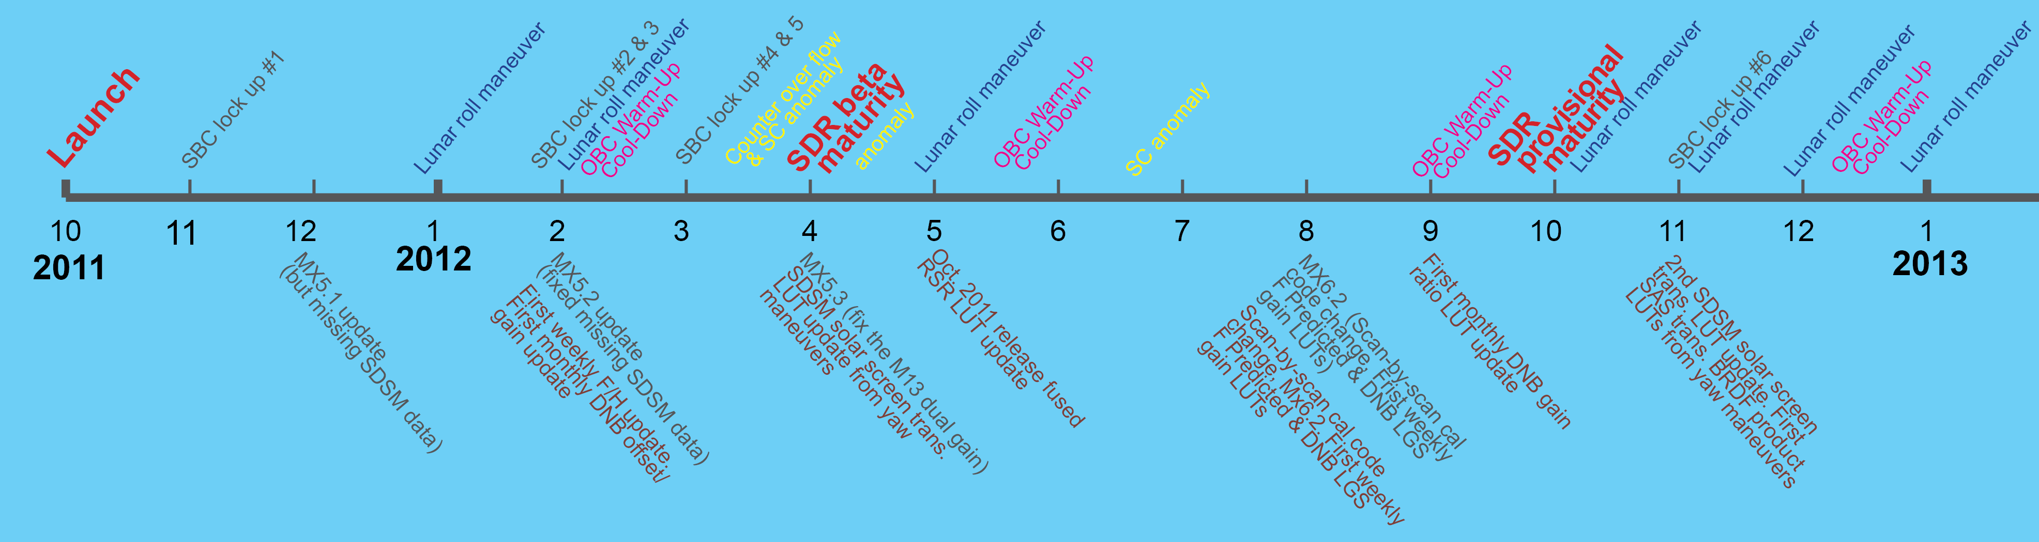
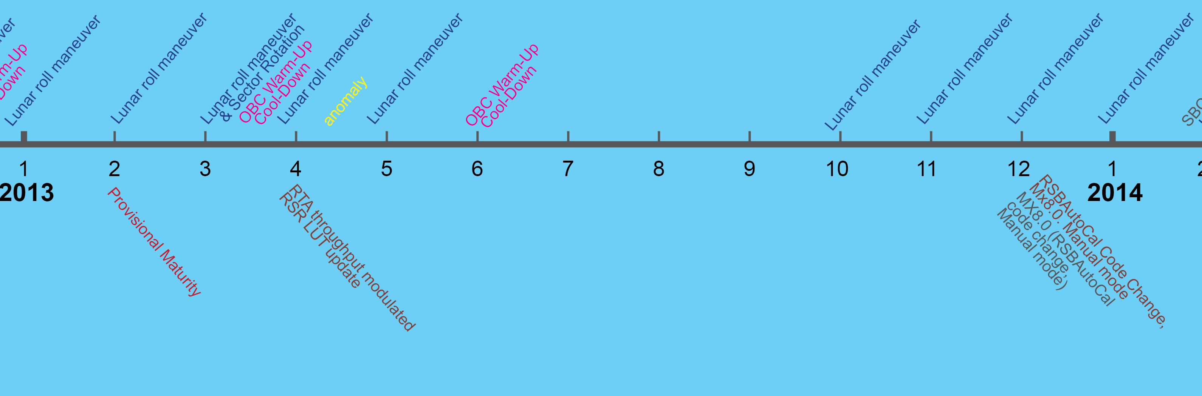
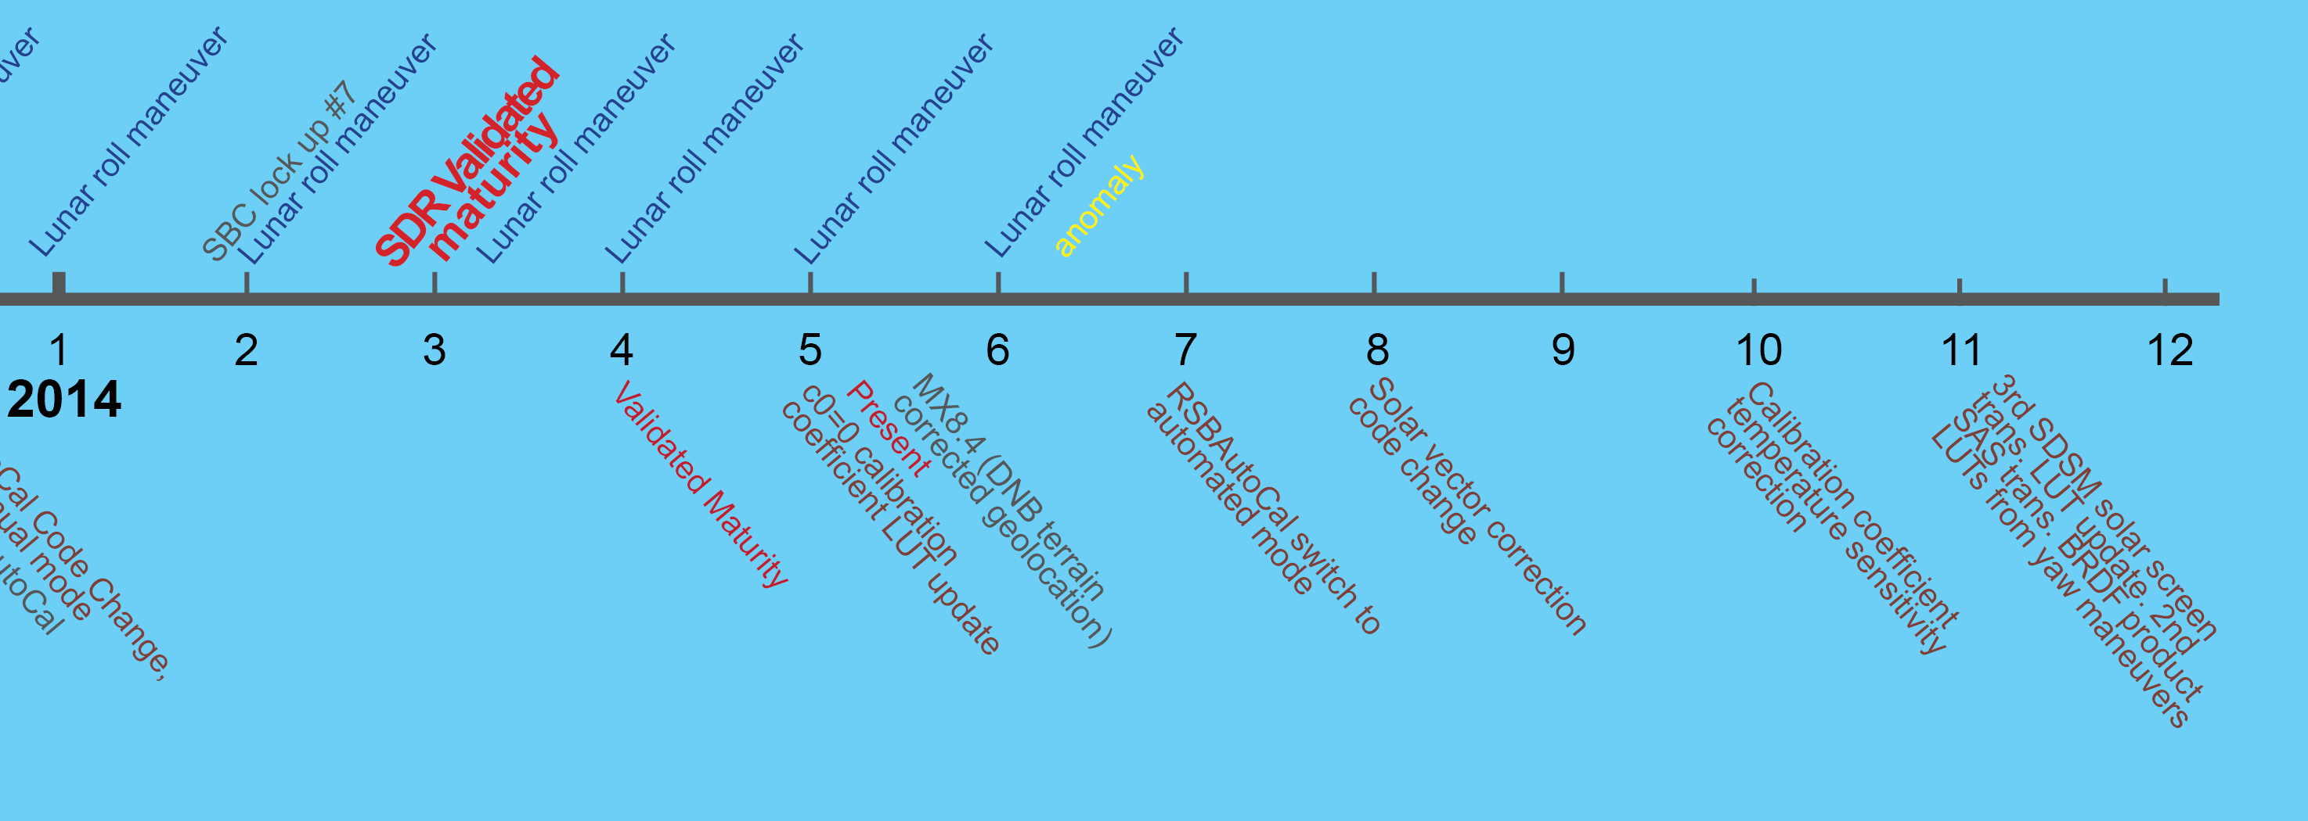
VIIRS Significant Events
For details, go to the VIIRS calibration knowledge base at: http://ncc.nesdis.noaa.gov

Slide 31
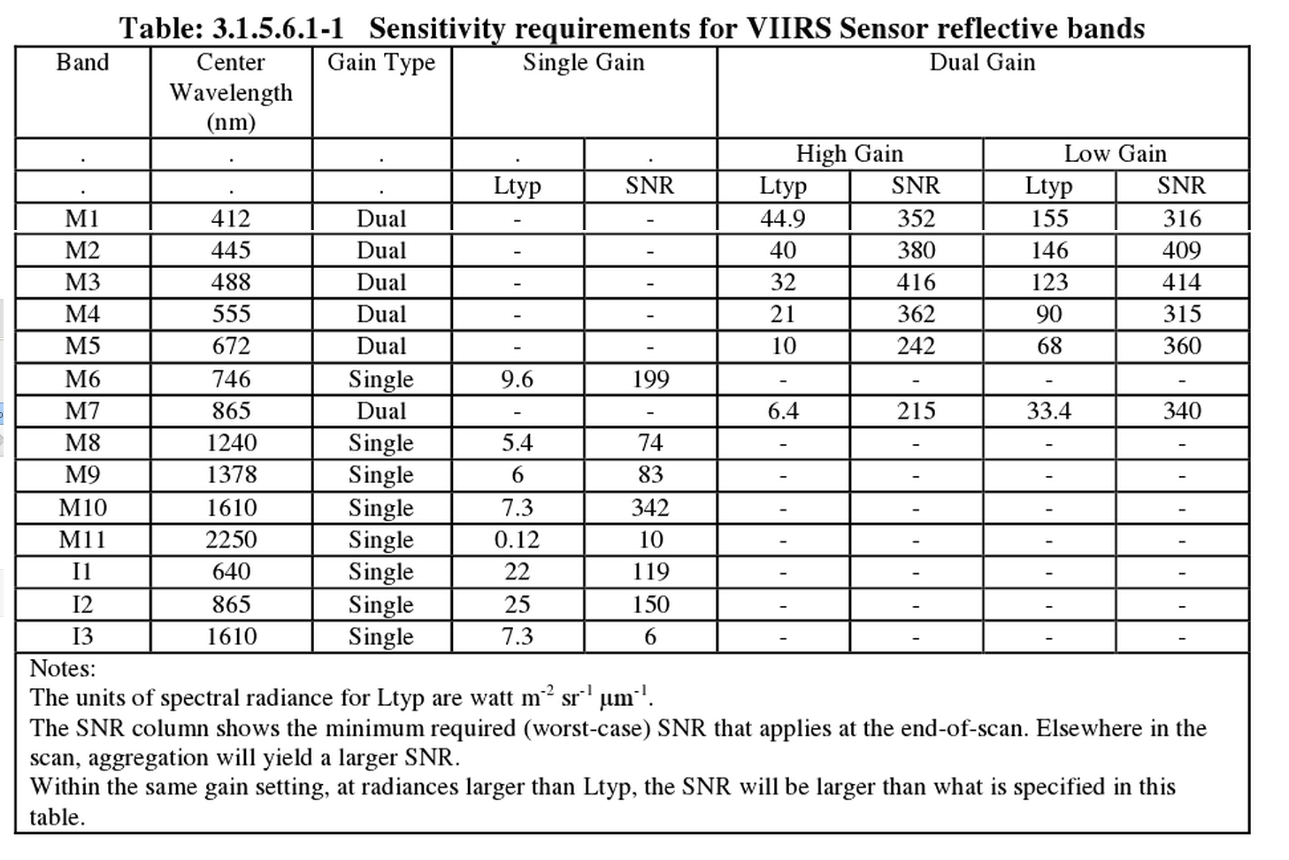
VIIRS Sensor Specification
- RSB sensitivity
Absolute radiometric calibration uncertainty for uniform scenes: < 2%
Source: JPSS VIIRS Performance Requirement Document
Code 472 472-00124

Slide 32
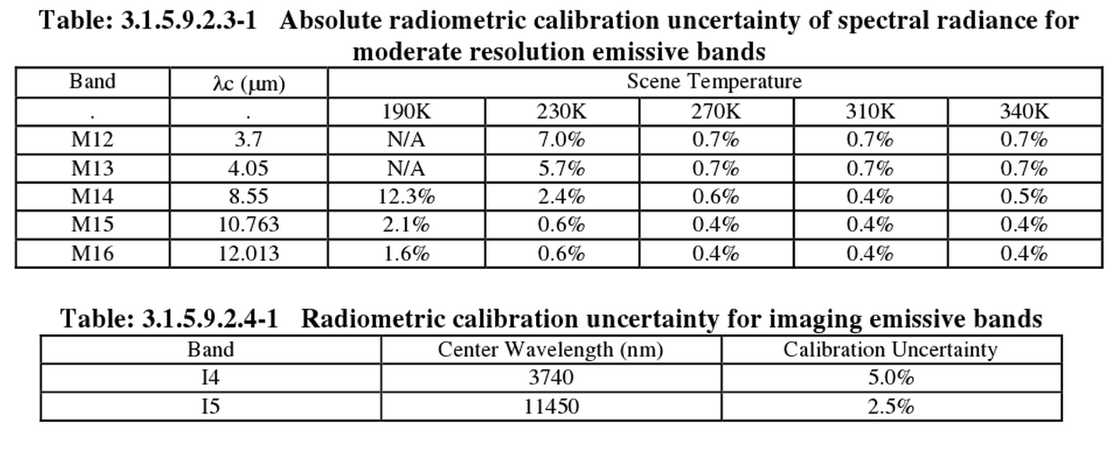
VIIRS Sensor Specification
- TEB Uncertainty
Source: JPSS VIIRS Performance Requirement Document
Code 472 472-00124

